Slide 1





Strings and Text Processing
Processing and Manipulating Text
SoftUni Team
Technical Trainers
Software University
http://softuni.bg

Slide 2

Table of Contents
What is a String?
Manipulating Strings
Comparing, Concatenating, Searching
Extracting Substrings, Splitting
Building and Modifying Strings
Why Is the + Operator Slow?
Using the StringBuilder Class

Slide 3
Questions
sli.do #tech-softuni

Slide 4

Strings

Slide 5
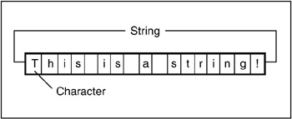
What is a String?
Strings are represented by System.String objects in .NET Framework
String objects contain an immutable (read-only) sequence of characters
Before initializing, a string variable has null value

Slide 6
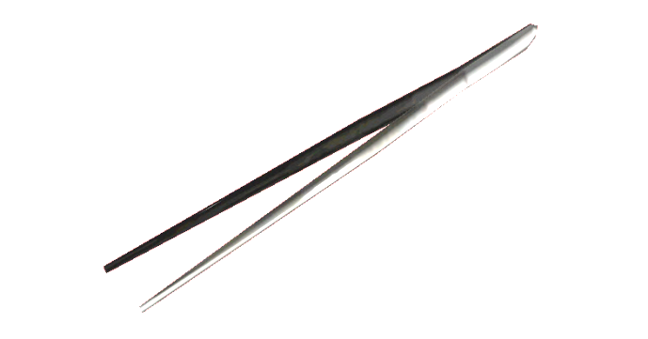

Manipulating Strings
Comparing, Concatenating, Searching, Extracting Substrings, Splitting

Slide 7
Comparing Strings
Several ways to compare two strings:
Dictionary-based string comparison
Case-insensitive
Case-sensitive
int result = string.Compare(str1, str2, true);
// result == 0 if str1 equals str2
// result < 0 if str1 is before str2
// result > 0 if str1 is after str2
int result = string.Compare(str1, str2, false);

Slide 8
Comparing Strings (2)
Equality checking by operator ==
Performs case-sensitive comparison
Using the case-sensitive Equals() method
The same effect like the operator ==
if (str1 == str2)
{
…
}
if (str1.Equals(str2))
{
…
}

Slide 9
Concatenating Strings
There are two ways to combine strings:
Using the Concat() method
Using the + or the += operators
Any object can be appended to a string
string str = string.Concat(str1, str2);
string str = str1 + str2 + str3;
string str += str1;
string name = "Peter";
int age = 22;
string s = name + " " + age; // → "Peter 22"

Slide 10

Searching in Strings
Finding a character or substring within given string
str.IndexOf(string term) – returns the index of the first occurrence of term in str
Returns -1 if there is no match
str.LastIndexOf(string term) – returns the index of the last occurrence of term in str
string email = "vasko@gmail.org";
int firstIndex = email.IndexOf("@"); // 5
int noIndex = email.IndexOf("/"); // -1
string verse = "To be or not to be..";
int lastIndex = verse.LastIndexOf("be"); // 16

Slide 11
Problem: Count substring occurrences
You are given a text and a pattern
Find how many times that pattern is in the text.
Overlapping is allowed
ababa caba
aba
aaaaaa
aa
3
5
Welcome to SoftUni
Java
0
Check your solution here: https://judge.softuni.bg/Contests/Practice/Index/320#1

Slide 12
Solution: Count substring occurrences
string input = Console.ReadLine().ToLower();
string pattern = Console.ReadLine().ToLower();
int counter = 0;
int index = input.IndexOf(pattern);
while (index != -1)
{
counter++;
index = input.IndexOf(pattern, index + 1)
}
Console.WriteLine(counter);

Slide 13
Extracting Substrings
Extracting substrings
str.Substring(int startIndex, int length)
str.Substring(int startIndex)
string filename = @"C:\Pics\Rila2005.jpg";
string name = filename.Substring(8, 8);
// name is Rila2005
string filename = @"C:\Pics\Summer2009.jpg";
string nameAndExtension = filename.Substring(8);
// nameAndExtension is Summer2009.jpg
0 | 1 | 2 | 3 | 4 | 5 | 6 | 7 | 8 | 9 | 10 | 11 | 12 | 13 | 14 | 15 | 16 | 17 | 18 | 19
C | : | \ | P | i | c | s | \ | R | i | l | a | 2 | 0 | 0 | 5 | . | j | p | g

Slide 14

Splitting Strings
To split a string by given separator(s) use the following method:
Example:
string[] Split(params char[] separator)
string listOfBeers = "Amstel, Zagorka, Tuborg, Becks.";
string[] beers = listOfBeers.Split(' ', ',', '.');
Console.WriteLine("Available beers are:");
foreach (string beer in beers)
{
Console.WriteLine(beer);
}

Slide 15

Other String Operations
Replacing and deleting Substrings, Changing Character Casing, Trimming

Slide 16
Replacing and Deleting Substrings
str.Replace(string match, string term) – replaces all occurrences of given string with another
The result is a new string (strings are immutable)
str.Remove(int index, int length) – deletes part of a string and produces a new string as result
string cocktail = "Vodka + Martini + Cherry";
string replaced = cocktail.Replace("+", "and");
// Vodka and Martini and Cherry
string price = "$ 1234567";
string lowPrice = price.Remove(2, 3);
// $ 4567

Slide 17
Problem: Text filter
You are given a text and a string of banned words
Replace all banned words in the text.
You should replace with "*", equal to the word's length
Linux, Windows
It is not Linux, it is GNU/Linux. Linux is merely the kernel, while GNU adds the functionality...
It is not *****, it is GNU/*****. ***** is merely the kernel, while GNU adds the functionality...
Check your solution here: https://judge.softuni.bg/Contests/Practice/Index/320#2

Slide 18
Solution: Text Filter
string[] banWords = Console.ReadLine()
.Split(…); // ToDo: Add seprators
string text = Console.ReadLine();
foreach (var banWord in banWords)
{
if (text.Contains(banWord))
{
text = text.Replace(banWord, new string('*', banWord.Length));
}
}
Console.WriteLine(text);
Contains(…) checks if string contains another string

Slide 19
Changing Character Casing
Using the method ToLower()
Using the method ToUpper()
string alpha = "aBcDeFg";
string lowerAlpha = alpha.ToLower(); // abcdefg
Console.WriteLine(lowerAlpha);
string alpha = "aBcDeFg";
string upperAlpha = alpha.ToUpper(); // ABCDEFG
Console.WriteLine(upperAlpha);

Slide 20
Trimming White Space
str.Trim() – trims whitespaces at start and end of string
str.Trim(params char[] chars)
str.TrimStart() and str.TrimEnd()
string s = " example of white space ";
string clean = s.Trim();
Console.WriteLine(clean); // example of white space
string s = " \t\nHello!!! \n";
string clean = s.Trim(' ', ',' ,'!', '\n','\t');
Console.WriteLine(clean); // Hello
string s = " C# ";
string clean = s.TrimStart(); // clean = "C# ";

Slide 21

String Operations
Exercises in class

Slide 22
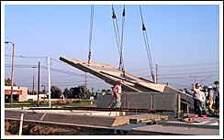
Building and Modifying Strings
Using the StringBuilder Class

Slide 23
StringBuilder: How It Works?
Capacity
StringBuilder:
Length = 9
Capacity = 15
H | e | l | l | o | , | C | # | !
used buffer
(Length)
unused buffer
StringBuilder keeps a buffer memory, allocated in advance
Most operations use the buffer memory and do not allocate new objects

Slide 24
Changing the Contents of a String
Use the System.Text.StringBuilder class for modifiable strings of characters:
Use StringBuilder if you need to keep adding characters to a string
public static string ReverseString(string s)
{
StringBuilder sb = new StringBuilder();
for (int i = s.Length - 1; i >= 0; i--)
{
sb.Append(s[i]);
}
return sb.ToString();
}
Notes:
Introducing the StringBuffer Class
StringBuffer represents strings that can be modified and extended at run time. The following example creates three new String objects, and copies all the characters each time a new String is created:
String quote = "Fasten your seatbelts, ";
quote = quote + "it's going to be a bumpy night.";
It is more efficient to preallocate the amount of space required using the StringBuffer constructor, and its append() method as follows:
StringBuffer quote = new StringBuffer(60); // allocate 60 chars
quote.append("Fasten your seatbelts, "); quote.append(" it's going to be a bumpy night. ");
StringBuffer also provides a number of overloaded insert() methods for inserting various types of data at a particular location in the string buffer.
Instructor Note
The example in the slide uses StringBuffer to reverse the characters in a string. A StringBuffer object is created, with the same length as the string. The loop traverses the String parameter in reverse order and appends each of its characters to the StringBuffer object by using append(). The StringBuffer therefore holds a reverse copy of the String parameter. At the end of the method, a new String object is created from the StringBuffer object, and this String is returned from the method.

Slide 25
The StringBuilder Class
StringBuilder(int capacity) constructor allocates in advance buffer of size capacity
Capacity holds the currently allocated space (in characters)
this[int index] (indexer in C#) gives access to the char value at given position
Length holds the length of the string in the buffer

Slide 26
The StringBuilder Class (2)
sb.Append(…) appends a string or another object after the last character in the buffer
sb.Remove(int startIndex, int length) removes the characters in given range
sb.Insert(int index, string str) inserts given string (or object) at given position
sb.Replace(string oldStr, string newStr) replaces all occurrences of a substring
sb.ToString() converts the StringBuilder to String

Slide 27
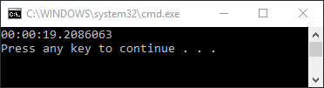
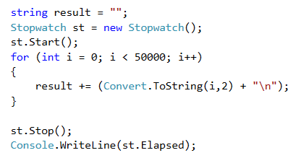
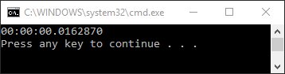
Demo: String concatenation
Given the code below try to optimize it to go under 10 secs.
Do not change the loop nor the Convert.ToString() method

Slide 28

Summary
Strings are immutable sequences of characters
Changes to the string create a new object, instead of modifying the old one
StringBuilder offers good performance
Regular expressions describe patterns for searching through text
Define special characters, operators and constructs for building complex patterns

Slide 29









Strings and Text Processing
https://softuni.bg/courses/programming-fundamentals

Slide 30

License
This course (slides, examples, demos, videos, homework, etc.) is licensed under the "Creative Commons Attribution-NonCommercial-ShareAlike 4.0 International" license
Attribution: this work may contain portions from
"Fundamentals of Computer Programming with C#" book by Svetlin Nakov & Co. under CC-BY-SA license
"C# Part I" course by Telerik Academy under CC-BY-NC-SA license
"C# Part II" course by Telerik Academy under CC-BY-NC-SA license

Slide 31




Trainings @ Software University
Software University Foundation – softuni.org
Software University – High-Quality Education, Profession and Job for Software Developers
softuni.bg
Software University @ Facebook
facebook.com/SoftwareUniversity
Software University Forums – forum.softuni.bg

